Slide 1
Aggregation Models in Machine Learning
Zhihao Huang
mrhuangzh@outlook.com

Slide 2
Overview
Some definitions and notations
--- Empirical Error and Generalization Error
--- Bias-variance Decomposition (for supervised learning)
Blending and BAGging (Bootstrap Aggregation)
Boosting
--- AdaBoost (Adaptive Boosting)
Decision Tree
--- C&RT (Classification and Regression Tree)
Random Forest
Something else (if there is spare time)
--- Cross Validation (n-fold cross validation)
--- Occam’s Razor

Slide 3
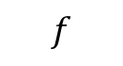
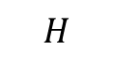
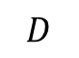
Generalization Error
$$H$$
denotes hypothesis set
$$f$$
denotes target function
$$D$$
denotes an underlying distribution
So the generalization error of h is defined by
$$R\left(h\right)=\underset{x\sim D}{Pr}\left[h\left(x\right)≠f\left(x\right)\right]=\underset{x\sim D}{E}\left[1_{h\left(x\right)≠f\left(x\right)}\right]$$
(for classification)
The generalization error of a hypothesis is not directly accessible to the learner since both the distribution D and the target function f are unknown.

Slide 4
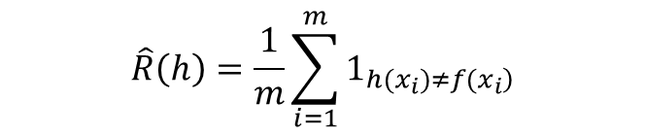
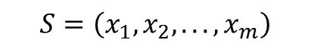
Empirical Error
However, the learner can measure the empirical error of a hypothesis on the labeled sample S.
A sample
$$S=\left(x_{1},x_{2},...,x_{m}\right)$$
So the empirical error is defined by
$$\hat{R}\left(h\right)=\frac{1}{m}\sum_{i=1}^{m}{1_{\left.h(x_{i})≠f(x_{i}\right)}}$$
Thus, the empirical error of h ∈ H is its average error over the sample S, while the generalization error is its expected error based on the distribution D.

Slide 5
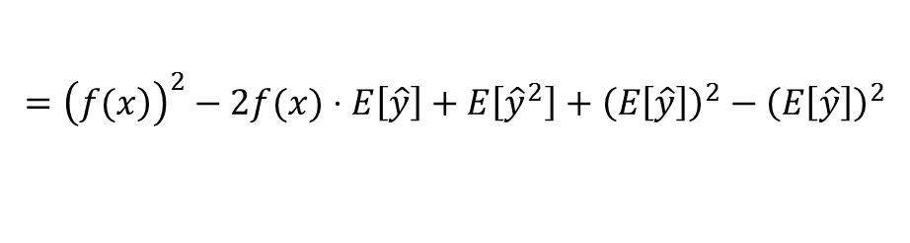
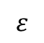
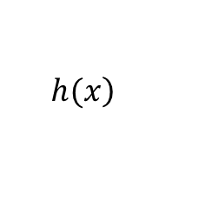
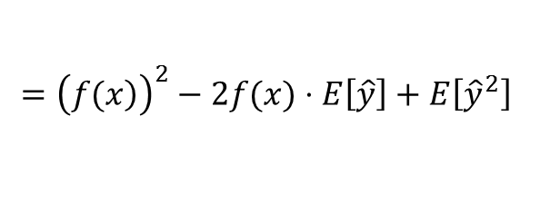
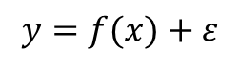
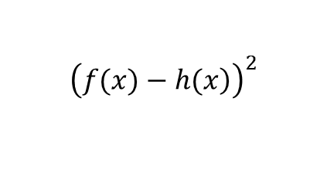
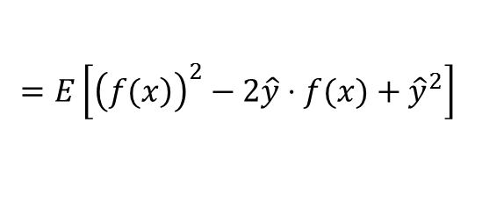
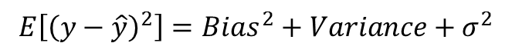
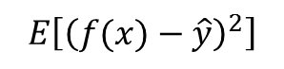
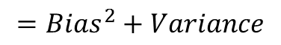
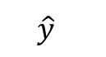
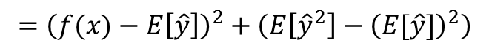
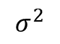
Bias-variance Decomposition
You must be familiar with squared error:
$${\left(\left.f(x)−h(x\right)\right)}^{2}$$
For any x ~ D, we substitute
$$\left.h(x\right)$$
by
$$\hat{y}$$
$$E\left[{\left(f(x)−\hat{y}\right)}^{2}\right]$$
$$=E\left[{\left(\left.f(x\right)\right)}^{2}−2\hat{y}⋅f(x)+{\hat{y}}^{2}\right]$$
$$={\left(\left.f(x\right)\right)}^{2}−2f(x)⋅E\left[\hat{y}\right]+E\left[{\hat{y}}^{2}\right]$$
$$={\left(\left.f(x\right)\right)}^{2}−2f(x)⋅E\left[\hat{y}\right]+E\left[{\hat{y}}^{2}\right]+{\left(E\left[\hat{y}\right]\right)}^{2}−{\left(E\left[\hat{y}\right]\right)}^{2}$$
$$={\left(f(x)−E\left[\hat{y}\right]\right)}^{2}+\left(E\left[{\hat{y}}^{2}\right]−{\left(E[\hat{y}]\right)}^{2}\right)$$
$$=Bias^{2}+Variance$$
Actually:
$$y=f(x)+ε$$
$$ε$$
hash zero mean and
$$σ^{2}$$
variance
$$E\left[{\left(y−\hat{y}\right)}^{2}\right]=Bias^{2}+Variance+σ^{2}$$

Slide 6
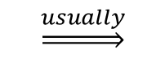
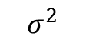
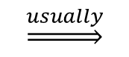
Trade-off between bias and variance
The error term
$$σ^{2}$$
is irreducible!
Lower bias
$$\underset{⇒}{usually}$$
Higher variance (due to large model complexity! Or too powerful? With more responsibility ☺)
Lower variance
$$\underset{⇒}{usually}$$
Higher bias (poor guy☹ with stable capability but useless…)
Difficulty: How to balance bias and variance to maximize performance?

Slide 7
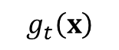
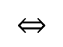
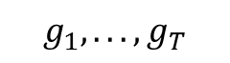
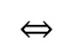
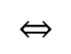
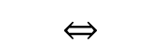
Aggregation
Let’s begin with a story:
Your T friends
$$g_{1},...,g_{T}$$
predict whether stock will go up as
$$g_{t}\left(x\right)$$
You could:
1. select the most trust-worthy friend from their usual performance
$$⇔$$
Validation
2. mix the predictions from all your friends uniformly
$$⇔$$
Let them vote
let them vote, but give some more ballots
3. mix the predictions from all your friends non-uniformly
$$⇔$$
if [t satisfies some condition] give some ballots to friend t
4. combine the predictions conditionally
$$⇔$$
Aggregation Models: mix or combine
hypotheses (for better performance)

Slide 8
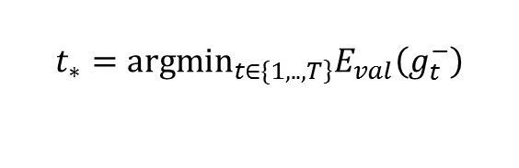
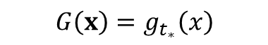
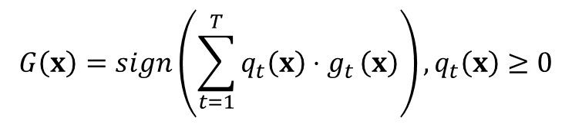
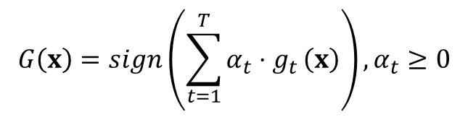
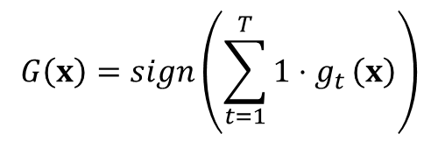
Mathematical Forms
1.select the most trust-worthy friend from their usual performance:
$$G\left(x\right)=g_{t_{∗}}\left(x\right)$$
with
$$t_{∗}=arg\min_{\left.t∈\{1,..,T\right\}}E_{val}\left(g_{t}^{−}\right)$$
2.mix the predictions from all your friends uniformly:
$$G\left(x\right)=sign\left(\sum_{t=1}^{T}{1⋅g_{t}}\left(x\right)\right)$$
3. mix the predictions from all your friends non-uniformly:
$$G\left(x\right)=sign\left(\sum_{t=1}^{T}{α_{t}⋅g_{t}}\left(x\right)\right),α_{t}≥0$$
4. combine the predictions conditionally:
$$G\left(x\right)=sign\left(\sum_{t=1}^{T}{q_{t}\left(x\right)⋅g_{t}}\left(x\right)\right),q_{t}\left(x\right)≥0$$
Aggregation Models: a rich family!

Slide 9
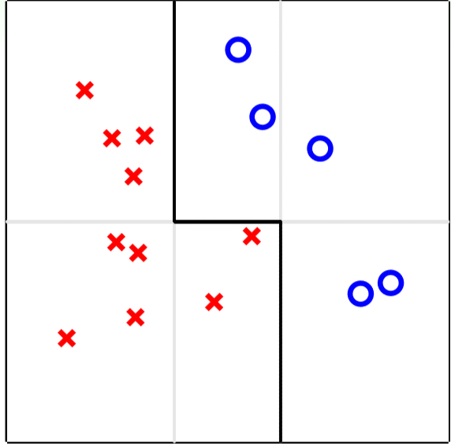
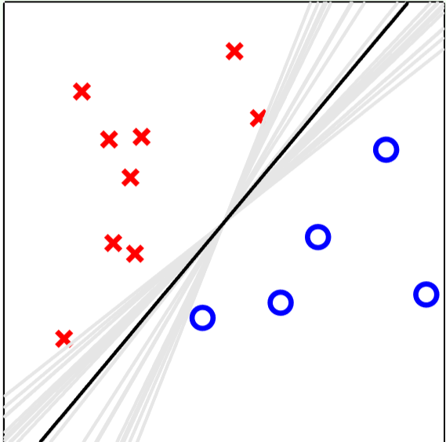
Why Might Aggregation Work?
mix different random-PLA hypotheses uniformly —G(x) ‘moderate’
mix different weak hypotheses uniformly —G(x) ‘strong’
proper aggregation ⇒ better performance?

Slide 10
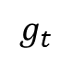
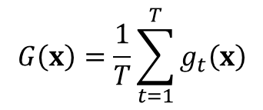
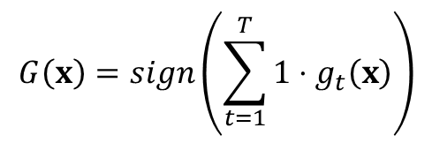
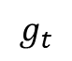
Uniform Blending
For classification:
$$G\left(x\right)=sign\left(\sum_{t=1}^{T}{1⋅g_{t}\left(x\right)}\right)$$
For regression:
$$G\left(x\right)=\frac{1}{T}\sum_{t=1}^{T}{g_{t}\left(x\right)}$$
Notes:
same (autocracy):
---as good as one single
2. Very different (diversity + democracy):
---majority can correct minority(for classification)
---average could be more accurate than individual(for regression)
$$g_{t}$$
$$g_{t}$$
We need diverse hypotheses:
even simple uniform blending can be better than any single hypothesis!
Uniform Blending: reduces variance for more stable performance

Slide 11
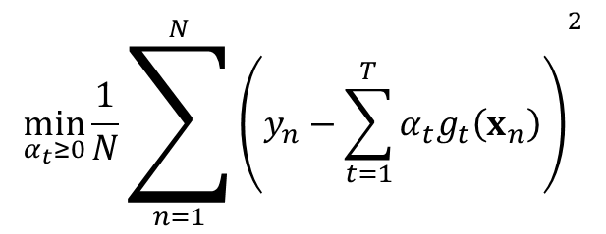
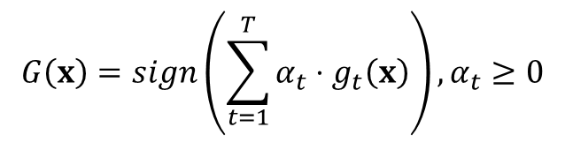
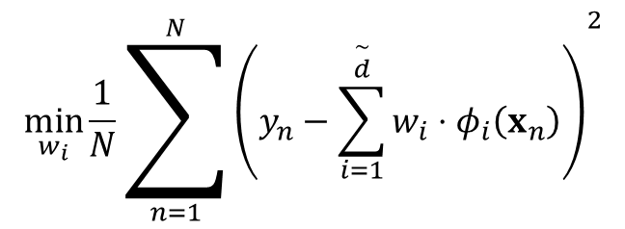
Linear Blending
Known gt, each to be given αt ballot:
$$G\left(x\right)=sign\left(\sum_{t=1}^{T}{α_{t}⋅g_{t}\left(x\right)}\right),α_{t}≥0$$
Linear blending for regression:
Linear regression + feature transform:
$$\min_{α_{t}≥0}\frac{1}{N}{\sum_{n=1}^{N}{\left(y_{n}−\sum_{t=1}^{T}{α_{t}g_{t}\left(x_{n}\right)}\right)}}^{2}$$
$$\min_{w_{i}}\frac{1}{N}{\sum_{n=1}^{N}{\left(y_{n}−\sum_{i=1}^{\overset{∼}{d}}{w_{i}⋅φ_{i}\left(x_{n}\right)}\right)}}^{2}$$
Like two-level learning, right?
Linear blending for regression = linear regression + feature transform + constraints

Slide 12
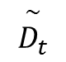
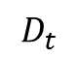
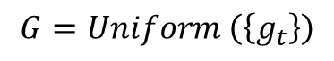
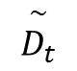
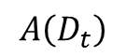
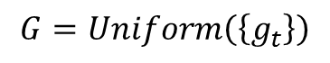
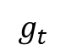
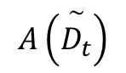
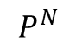

Any blending:
powerful, achieves conditional blending
But danger of overfitting, as always!
Blending ‘useful’ in practice, despite the computational burden!
Bootstrapping:
Bootstrap sample : re-sample N examples from D uniformly with replacement --- can also use arbitrary N’ instead of original N
$$\overset{∼}{D_{t}}$$
Bootstrap aggregation(BAGging):
Consider a physical iterative process that for t = 1, 2, …, T
Request size-N’ data from bootstrapping
2. Obtain by
3. And then return
Virtual aggregation:
Consider a virtual iterative process that for t = 1, 2, …, T
Request size-N data from (i.i.d.)
Obtain by algorithm
And then return
$$\overset{∼}{D_{t}}$$
$$D_{t}$$
$$P^{N}$$
$$g_{t}$$
$$g_{t}$$
$$A\left(\overset{∼}{D_{t}}\right)$$
$$A\left(D_{t}\right)$$
$$G=Uniform \left(\left\{g_{t}\right\}\right)$$
$$G=Uniform\left(\left\{g_{t}\right\}\right)$$

Slide 13


BAGging
Bootstrap aggregation: a simple meta algorithm on top of base algorithm A
BAGging pocket in Action:
Very diverse from bagging
Proper non-linear boundary after aggregating binary classifiers.
$$g_{t}$$
Bagging works reasonably well if base algorithm sensitive to data randomness

Slide 14


Motivation of Boosting
$$g_{t}$$
Students: simple hypotheses (like vertical/horizontal lines)
Class(Aggregation): sophisticated hypothesis G (like black curve)
Teacher: a tactic learning algorithm that directs the students to focus on key examples (wrong-doing)

Slide 15



Weighted empirical error on D:
$$\hat{R}\left(h\right)=\frac{1}{4}\sum_{n=1}^{4}{u_{n}^{t}⋅⟦y_{n}≠h\left(x_{n}\right)⟧}$$
Goal:
‘improving’ bagging for binary classification:
How to re-weight for more diverse hypotheses?

Slide 16





Re-weighting for More Diverse Hypothesis
$$g_{t}←\underset{h∈H}{argmin}\left(\sum_{n=1}^{N}{u_{n}^{\left(t\right)}⋅⟦y_{n}≠h\left(x_{n}\right)⟧}\right)$$
$$g_{t+1}←\underset{h∈H}{argmin}\left(\sum_{n=1}^{N}{u_{n}^{\left(t+1\right)}⋅⟦y_{n}≠h\left(x_{n}\right)⟧}\right)$$
$$u^{\left(t+1\right)}$$
$$g_{t}$$
Idea: construct to make random-like
$$\frac{\sum_{n=1}^{N}{u_{n}^{\left(t+1\right)}⋅⟦y_{n}≠g_{t}\left(x_{n}\right)⟧}}{\sum_{n=1}^{N}{u_{n}^{\left(t+1\right)}⋅⟦y_{n}≠g_{t}\left(x_{n}\right)⟧}+\sum_{n=1}^{N}{u_{n}^{\left(t+1\right)}⟦y_{n}=g_{t}\left(x_{n}\right)⟧}}=\frac{\sum_{n=1}^{N}{u_{n}^{\left(t+1\right)}⋅⟦y_{n}≠g_{t}\left(x_{n}\right)⟧}}{\sum_{n=1}^{N}{u_{n}^{\left(t+1\right)}}}=\frac{1}{2}$$

Slide 17







$$u_{n}^{\left(t+1\right)}$$
$$u_{n}^{\left(t+1\right)}$$
Need: (total of incorrect) = (total of correct)
$$ε_{t}$$
‘optimal’ re-weighting under weighted incorrect rate :
Multiply incorrect ;
Multiply correct .
$$∝\left(1−ε_{t}\right)$$
$$∝ε_{t}$$

Slide 18

AdaBoost(Adaptive Boosting)
Adaptive Boosting = weak base learning algorithm (student)
+ optimal re-weighting factor (teacher)
+ ‘magic’ linear aggregation (class)

Slide 19





Theoretical Guarantee of AdaBoost
Theorem
$$\hat{R}\left(G\right)≤exp\left[−2\sum_{t=1}^{T}{{\left(\frac{1}{2}−ε_{t}\right)}^{2}}\right]$$
From VC Bound
$$R\left(G\right)≤\hat{R}\left(G\right)+Ο\left(\sqrt{Ο\left(d_{VC}\left(H\right)⋅TlogT\right)⋅\frac{logN}{N}}\right)$$
First term can be small:
$$ε_{t}<\frac{1}{2}$$
always
$$\hat{R}\left(G\right)=0$$
after
$$T=Ο\left(logN\right)$$
iterations if
Second term can be small: Overall grows ‘slowly’ with T
AdaBoost has strong theoretical guarantee. That’s what I like.

Slide 20



Decision Stump
Want: a ‘weak’ learning algorithm A that minimizes
$$\hat{R}\left(h\right)=\frac{1}{N}\sum_{n=1}^{N}{u_{n}⋅⟦y_{n}≠h\left(x_{n}\right)⟧}$$
a little bit.
A popular choice: decision stump
Three parameters: feature i, threshold \theta, direction s
$$h_{s,i,θ}\left(x\right)=s⋅sign\left(x_{i}−θ\right)$$
Physical meaning in 2D: vertical/horizontal lines
Efficient to optimize:
$$Ο\left(d⋅NlogN\right)$$
time
Decision stump model:
Allows efficient minimization of R-hat but perhaps too weak to work by itself!

Slide 21


AdaBoost in Action(A simple data set)

Slide 22


AdaBoost in Action(A simple data set)

Slide 23


AdaBoost in Action(A simple data set)
‘Teacher’-like algorithm works!

Slide 24

AdaBoost in Action(A complicated data set)
AdaBoost-Stump: non-linear yet efficient

Slide 25

Weird AdaBoost

Slide 26

AdaBoost-Stump in application
The world’s first ‘real-time’ face detection program!

Slide 27


Decision Tree
A traditional learning model that realizes conditional aggregation
$$G\left(x\right)=\sum_{t=1}^{T}{q_{t}\left(x\right)⋅g_{t}\left(x\right)}$$
1.Base hypothesis gt(x):
Leaf at end of path t, a constant here
2.Condition qt(x):
Whether x on path t?
3.Usually with simple internal nodes
Decision tree: arguably one of the most human-mimicking models

Slide 28


Disclaimers about Decision Tree
Decision tree: mostly heuristic but useful on its own

Slide 29

Recursive View of Decision Tree
Tree = (root, sub-trees)

Slide 30


A base decision tree algorithm
$$G\left(x\right)=\sum_{c=1}^{C}{⟦b\left(x\right)=c⟧G_{c}\left(x\right)}$$
Four choices:
1.Number of branches 2.Braching criteria
3.Termination criteria 4.base hypothesis

Slide 31



C&RT: bi-branching by purifying
Branching by purifying
$$b\left(x\right)=\underset{h\left(x\right)}{argmin}\sum_{c=1}^{2}{|D_{c}|}⋅impurity\left(D_{c}\right)$$
For regression
$$impurity\left(D\right)=\frac{1}{N}\sum_{n=1}^{N}{{\left(y_{n}−\overline{y}\right)}^{2}},\overline{y}=average\left\{y_{n}\right\}$$
For classification
$$1−\sum_{k=1}^{K}{{\left(\frac{\sum_{n=1}^{N}{⟦y_{n}=k⟧}}{N}\right)}^{2}}$$
Gini index =
Termination criteria:
All yn the same: impurity = 0
All xn the same: no decision stumps

Slide 32

Basic C&RT Algorithm
Easily handle binary classification, regression and multi-class classification!

Slide 33





Regularization by Pruning
Fully-grown tree: R-hat(G) = 0 if all xn different
But overfit(with large R(G)) because low-level trees built with small Dc
Need a regularizer:
$$Ω\left(G\right)=NumberOfLeaves\left(G\right)$$
$$\underset{AllPossibleG}{argmin}\hat{R}\left(G\right)+λΩ\left(G\right)$$
And we get pruned decision tree:
Cannot enumerate all possible G computationally, often consider only:
$$G^{\left(\text{0}\right)}\text{=}$$
Fully-grown tree
$$G^{\left(i\right)}\text{=}\underset{G}{argmin}\hat{R}\left(G\right)$$
such that G is one-leaf removed from
$$G^{\left(i−1\right)}$$
How to choice \lambda? ---Validation

Slide 34


Decision Tree in Action(A simple data set)

Slide 35


Decision Tree in Action(A simple data set)

Slide 36


Decision Tree in Action(A simple data set)

Slide 37


Decision Tree in Action(A simple data set)
C&RT: ‘divide-and-conquer’

Slide 38


Decision Tree in Action(A complicated data set)
C&RT: even more efficient than AdaBoost-Stump

Slide 39


Random Forest
Putting them together to realize aggregation of aggregation

Slide 40


1.Highly parallel!
2.Inherit pros of C&RT
3.Eliminate cons of fully-grown tree(Aggregation)
---Where is randomness of random forest?
---Bootstrapping!
Can we make more randomness to make random forest more randomly?

Slide 41







Diversifying by Feature Projection
Another possibility for diversity:
Randomly sample d’ features from x
When sampling index
$i_{i},i_{2},...,i_{d′}$:
$$Φ\left(x\right)=\left(x_{i_{1}},x_{i_{2}},...,x_{i_{d′}}\right)$$
$$∈Z$$
Often:
$$d′<<d$$
Efficient for large d
$Z∈ℝ^{d′}$:
A random subspace of
$$X∈ℝ^{d}$$
Original RF re-sample new subspace for each in C&RT
$$b\left(x\right)$$
$$RF=BAGging+random−subspaceC\&RT$$
Can be more randomly by feature expansion(with projection matrix), but we may have no enough time to talk about it ☹

Slide 42








Random Forest in Action(a simple data set)
$$m=\#NotSampledAfterN′Drawings$$
$${\left(1−\frac{1}{N}\right)}^{N}$$
Probability for to be not sampled after N’ drawings if N = N’:
$$\left(x_{n},y_{n}\right)$$
$$\lim_{N→∞}{\left(1−\frac{1}{N}\right)}^{N}=\frac{1}{e}$$
$$m≈\frac{1}{e}N$$
$$⇒$$

Slide 43


Random Forest in Action(a simple data set)

Slide 44


Random Forest in Action(a simple data set)

Slide 45


Random Forest in Action(a simple data set)
‘smooth’ and large-margin-like boundary with many trees

Slide 46


Random Forest in Action(a complicated data set)

Slide 47


Random Forest in Action(a complicated data set)
‘easy yet robust’ nonlinear model

Slide 48


Random Forest in Action(a complicated and noisy data set)

Slide 49


Random Forest in Action(a complicated and noisy data set)

Slide 50


Random Forest in Action(a complicated and noisy data set)
cons of RF: may need lots of trees if the whole random process too unstable —should double-check stability of G to ensure enough trees
Noise corrected by voting!

Slide 51




Cross Validation(n-fold cross validation)
$$θ$$
denote the vector of free parameters of the algorithm
Fix \theta, ﬁrst randomly partitioning a given sample S of m labeled examples into n subsamples, or folds.
The ith fold is thus a labeled sample
$$\left(\left(x_{i1},y_{i1}\right),\left(x_{i2},y_{i2}\right),...,\left(x_{im_{i}},y_{im_{i}}\right)\right)$$
of size mi
L: loss function
The folds are generally chosen to have equal size, that is mi = m/n
In machine learning applications, n is typically chosen to be 5 or 10.
Cross validation can be also used to model selection

Slide 52

Occam’s Razor
An explanation of the data should be made as simple as possible, but no simpler. ---Albert Einstein? (1879-1955)
entia non sunt multiplicanda praeter necessitatem
(entities must not be multiplied beyond necessity)
---William of Occam (1287-1347)
‘Occam’s razor’ for trimming down unnecessary explanation

Slide 53



Occam’s Razor for Learning
Which one do you prefer?
Simple hypothesis h: specified by few parameters
$$⇒$$
Small hypothesis/model complexity
Simple model H: contains small number of hypotheses
The simplest model that ﬁts the data is also the most plausible.

Slide 54
References
Machine Learning, Hsuan-Tien Lin, National Taiwan University.
Foundations of Machine Learning, Mehryar Mohri, Afshin Rostamizadeh, and Ameet Talwalkar, MIT Press, 2012.
The Elements of Statistical Learning, Trevor Hastie, Robert Tibshirani, and Jerome Friedman, Springer.
END

Slide 55
Q&A

